Slide 1
Online auction system
By :
Muhammad tarek refaat sec:11
Mohammed hamdy attia sec:11
Ahmed kahled masoud sec:2
Professor: Samah Ibrahim

Slide 2
introduction
Our idea is about auctions systems mainly make the most happened auctions
make it more easy , cheap , comfortable for all customers join that auction
That system is flexible for all types of auctions like auction made by charities , governments , normal people just wants to sell things have great values like painted pictures ,banks

Slide 3
Our Idea
Our idea is based on make customer join the auction and see the details of the things that would be sold by two ways through a web site easily to be accessed from internet or from mobile application (android or IOS) all of them is online
Our document will have all most details of that system

Slide 4
Notes:
Use case

Slide 5
Use case name: Monitor Auction ID:1 Priority: High
Actor:Administrator
Description: Administrator able to monitor users who enter the online Auction and operation of Selecting items.
Trigger: there is a certain number that enter over the Online Auction.
Type: external Temporal
Major steps:
1-Users make Account .
2-users enter the online Auction.
3-some of users Heritage off the Online Auction because of appropriating number of users is complete.
4-Monitor items that users selected.
Summary:
Input :Monitor entered users &items selected output: Knowing users are entering&items
Source: Administrator Destination: users&items
Notes:
Use case table

Slide 6
Use case name: Get list items of Auction ID:2 Priority: High Actor:User Description: user wants to know and Recognize Existing items in Auction to Select and Withdraw a certain item. Trigger: user wants to select a certain item and it’s necessary to know existing items Type: external Temporal Major steps: 1-Create account to Register online Auction(Website) 2-knowing the Date of Online Auction and when finshed Summary: Input : Regsiter the online Auction with account output: Getting a certain of items Source: Online Auction(system or Administrator) Destination: users
Notes:
Use case table

Slide 7
Use case name: Select items ID:3 Priority: High Actor:User Description: user wants to select an item Trigger: user wants to select a certain item like Royal car because it’s so nice . Type: external Temporal Major steps: 1-Create account to Register online Auction(Website) 2- Getting a list of items
3-Select&withdraw a certain item Summary: Input : Knowing &Recognizing list of item to select item output: Getting items Source: Online Auction( Administrator) Destination: users
Notes:
Use case table

Slide 8
Use case name: Modify bid items ID:4 Priority: High Actor: User Description: user wants to remove and add some of items. Trigger: user wants to Remove a certain item because this item not great&Beauty and he wants to select another item. Type: external Temporal Major steps: 1-Create account to Register online Auction(Website) 2- Getting a list of items
3-Select&withdraw a certain item
4-user wants to remove a certain item and add another item Summary: Input : Knowing &Recognizing list of item to select item output: Getting items Source: Online Auction( Administrator) Destination: users
Notes:
Use case table

Slide 9
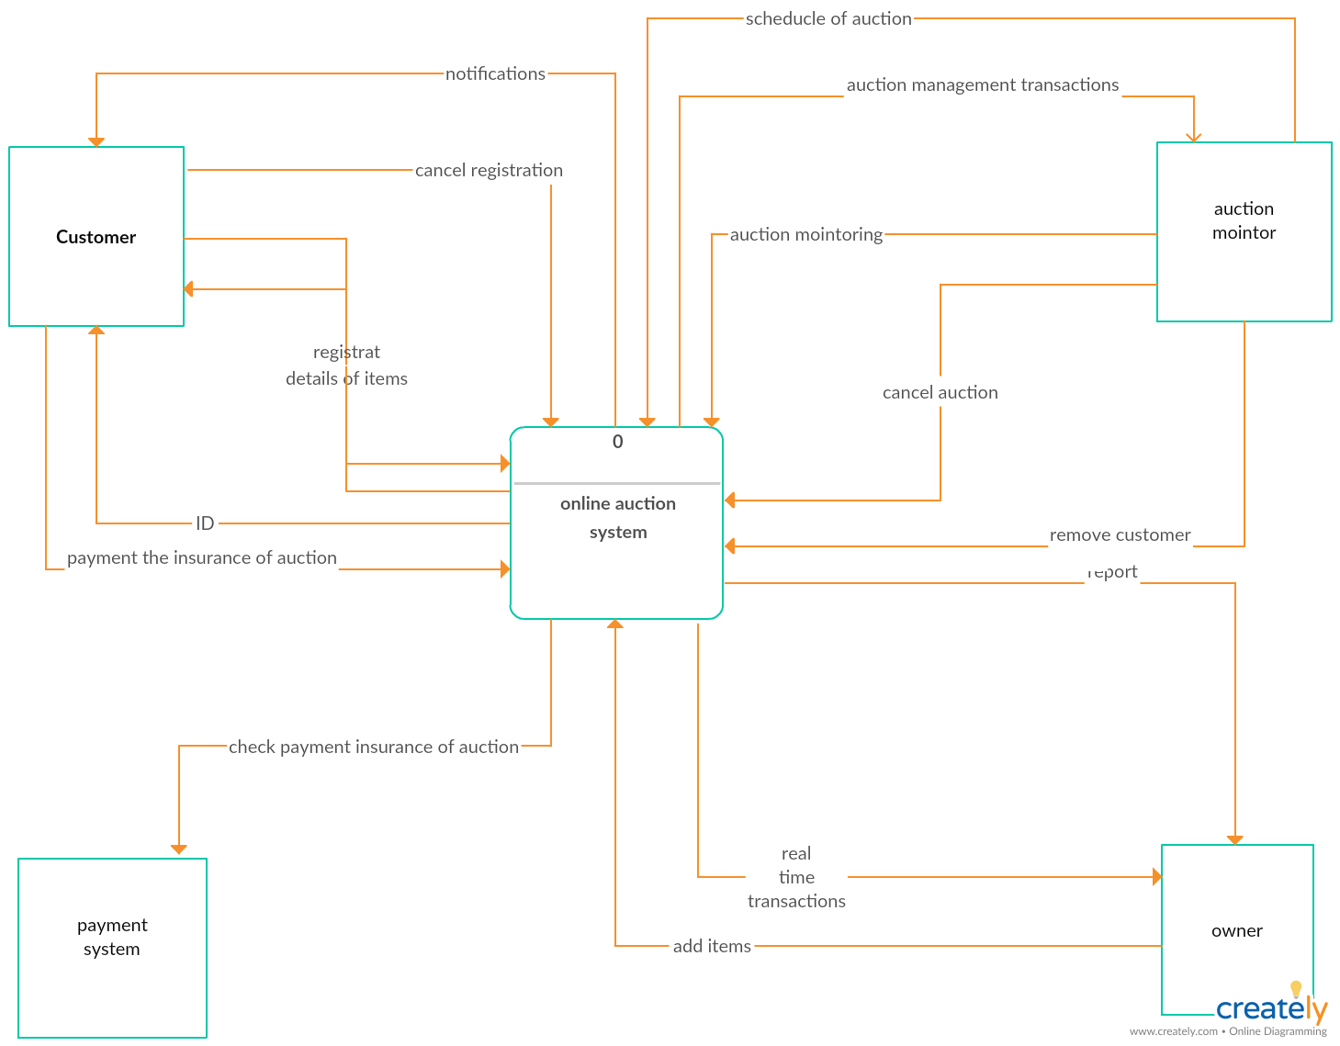
Notes:
Context diagram

Slide 10
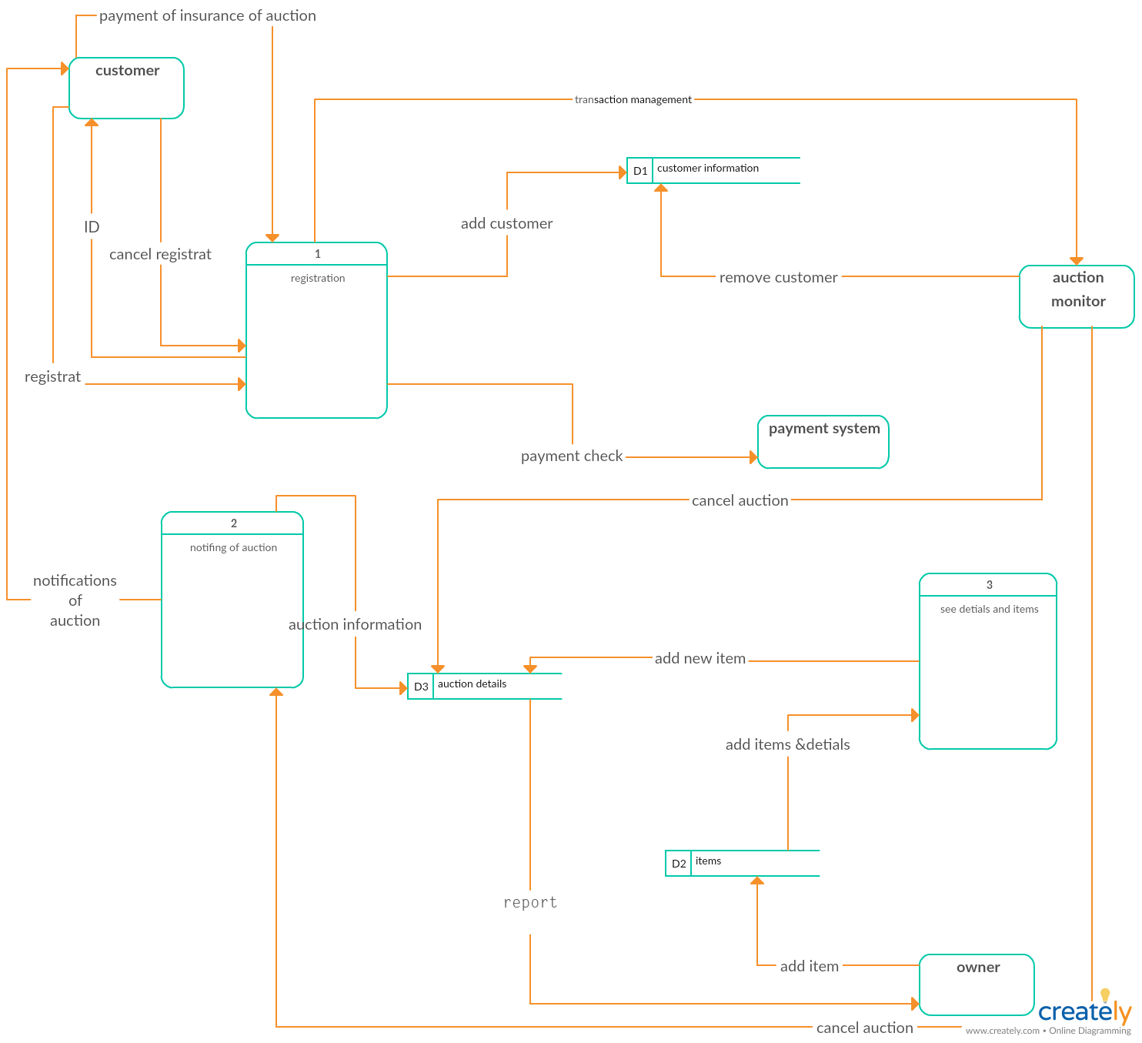
Notes:
DFD level 1

Slide 11
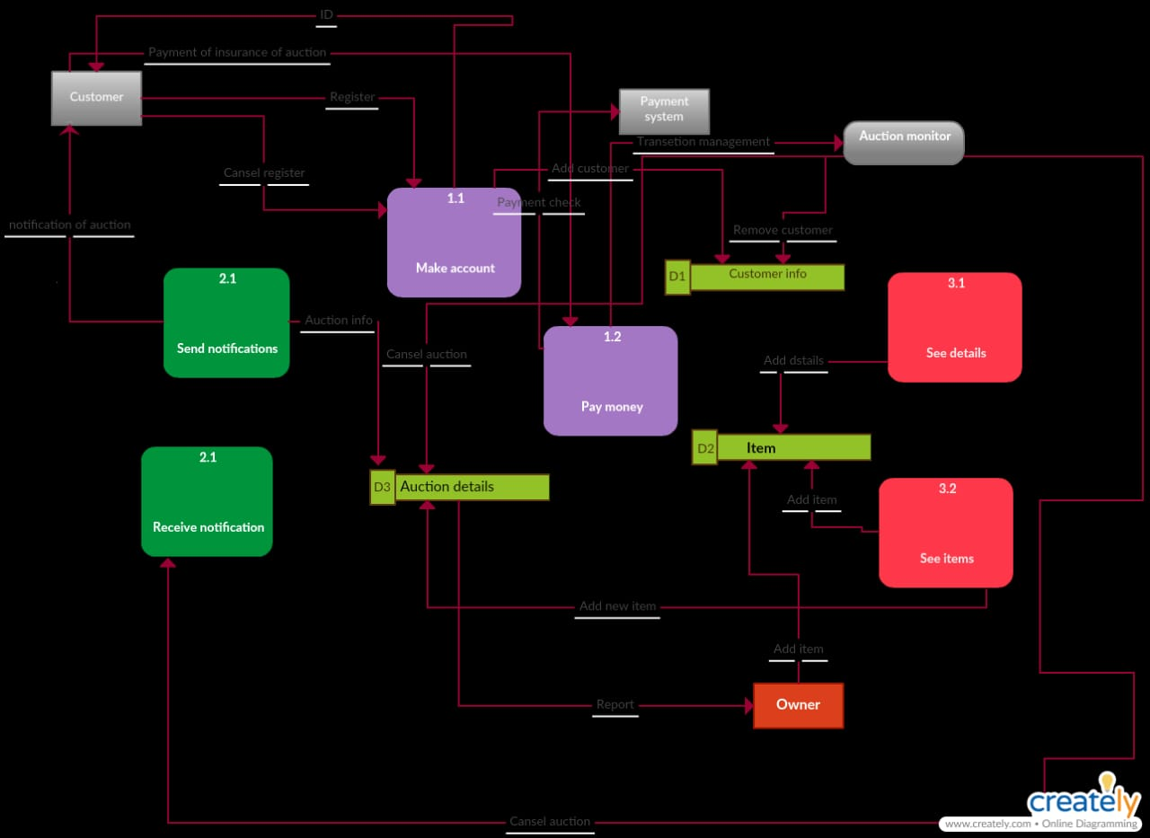
Notes:
DFD level 2

Slide 12
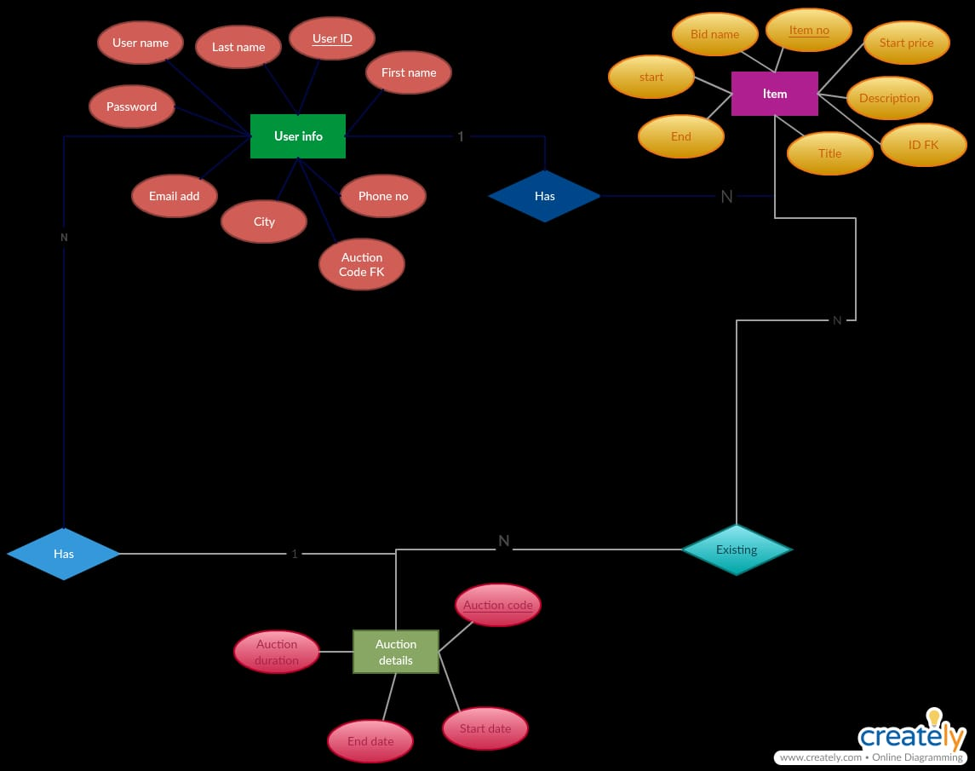
Notes:
Logical ERD

Slide 13
Wtd Score | Score (1-5)* | Alt 3: Auction | Wtd Score | Score (1-5)* | Alt 2: Auction | Wtd Score | Score (1-5)* | Alt 1: Auction | Relative Importance (Weight) | Evaluation Criteria
75 | 5 | Developed in Java would like to develop in-house Java skills | 45 | 3 | Developed in C and Java; would like to develop in-house Java skills | 15 | 1 | Developed in C; little interest in developing C skills in-house | 15 | Technical Issues: Develops desirable in-house skills
75 | 5 | Orders saved to a number of file formats | 60 | 4 | Flexible export features for passing order information to other systems | 45 | 3 | Orders sent as e-mail files | 15 | Integration with existing systems
10 | 1 | None | 50 | 5 | Tom in IS Support has had limited, but positive experience with this program. | 10 | 1 | None | 10 | Experience with product
75 | 3 | $200 per year fee | 100 | 4 | $700 initial charge; no yearly fees | 125 | 5 | $150 initial charge | 25 | Economic Issues: Cost
30 | 2 | Brand-new product; few companies Have experience | 75 | 5 | Program used by other retail hotel | 75 | 5 | Program used by other retail hotel | 15 | Organizational Issues Demonstrated product in market
60 | 3 | Yes, but not easy | 100 | 5 | Yes, easy to do | 20 | 1 | No | 20 | Customizable interface
325 |  |  | 430 |  |  | 290 |  |  | 100 | TOTAL
Notes:
Alternative matrix

Slide 14
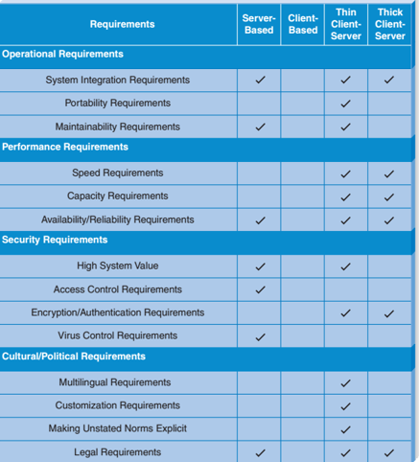
Notes:
Architecture Design

Slide 15
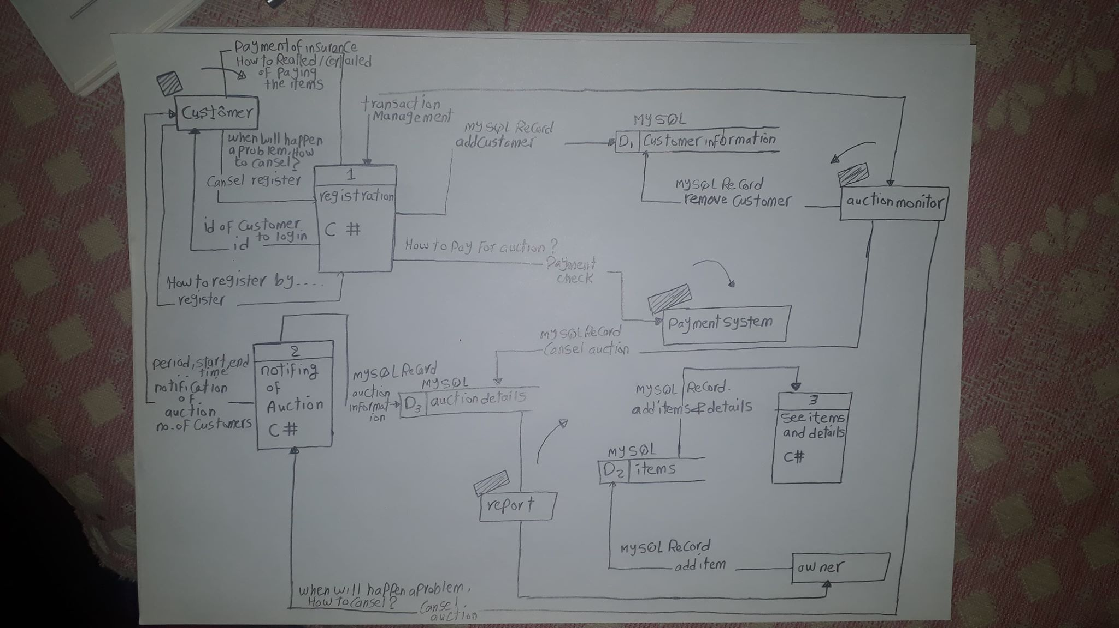
Notes:
Physical DFD level 1

Slide 16
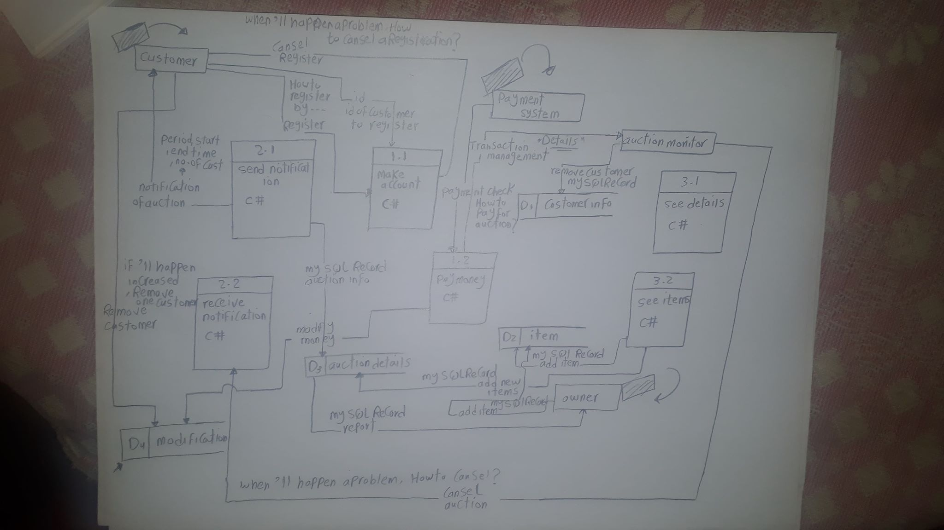
Notes:
Physical DFD level 2

Slide 17
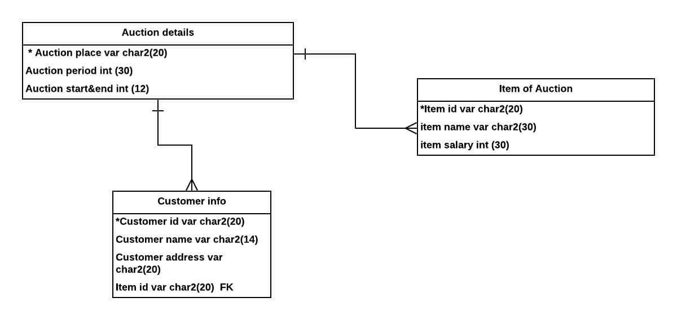
Notes:
Physical ERD

